Slide 1
Botic
privacy aware chatbot
PRESENTATION BY ALABAMA LIQUID SNAKE

Slide 2
1
MEET THE TEAM

Slide 3





Hello!
We Are Alabama Liquid Snake
Lesego Mabe
Peter Msimanga
Alicia Mulder
Kyle Gaunt
Justin Grenfell

Slide 4
BOTIC
The privacy aware chatbot

Slide 5
2
ARCHITECTURAL DESIGNS

Slide 6
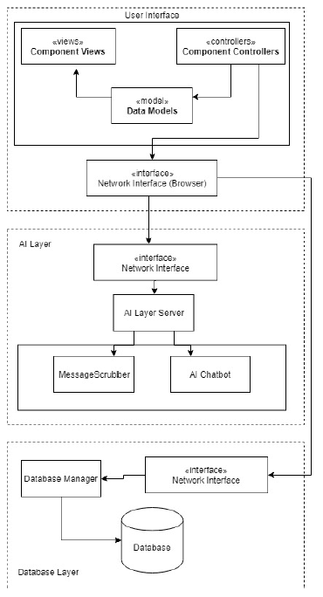
SYSTEM TYPE
Interactive system, focused on the customer's interaction with the Chatbot.
interaction begins and ends with the customer
N-tier architecture breaks the system down to a number of relatively
independent and loosely coupled layers
ARCHITECTURAL STRUCTURE
3-tier architectural style for the 1st level of granularity.
independent and loosely coupled layers makes the testing and the development of the system less complicated
maintenance and further updates of the system will benefit as well
user interface (MVC)
Angular framework
neural network
message scrubber, chatbot
database
database manager

Slide 7
Core Functionalities
Customer support neural network ticketing system
training of network
building of chatbot service

Slide 8
Core Functionalities
2. Private information scraping and classification
real time text analysis using FastText
information classification severity index

Slide 9
Core Functionalities
3. Administration and customization suite
super-user privileges
system setup and customization
region specific setup options

Slide 10
Core Functionalities
4. Client representative response suite
response suggestion functionality
email response system
real-time response from CR to client

Slide 11
Core Functionalities
5. Proprietary response digest
company specific responses
company specific data collection

Slide 12
DEMO

